Slide 1
WELCOME
TO THE
1711th Anniversary of
CONSTANTINE'S VICTORY IN ROME
October 28, 312 A.D.

Slide 2
AND WELCOME
TO THIS ROYAL
RECOGNITION & CHARITY GALA
HAWAII, October 28, 2023
At the Hilton Hawaiian Village Resort

Slide 3
THE
ROYAL
PROCESSION

Slide 4
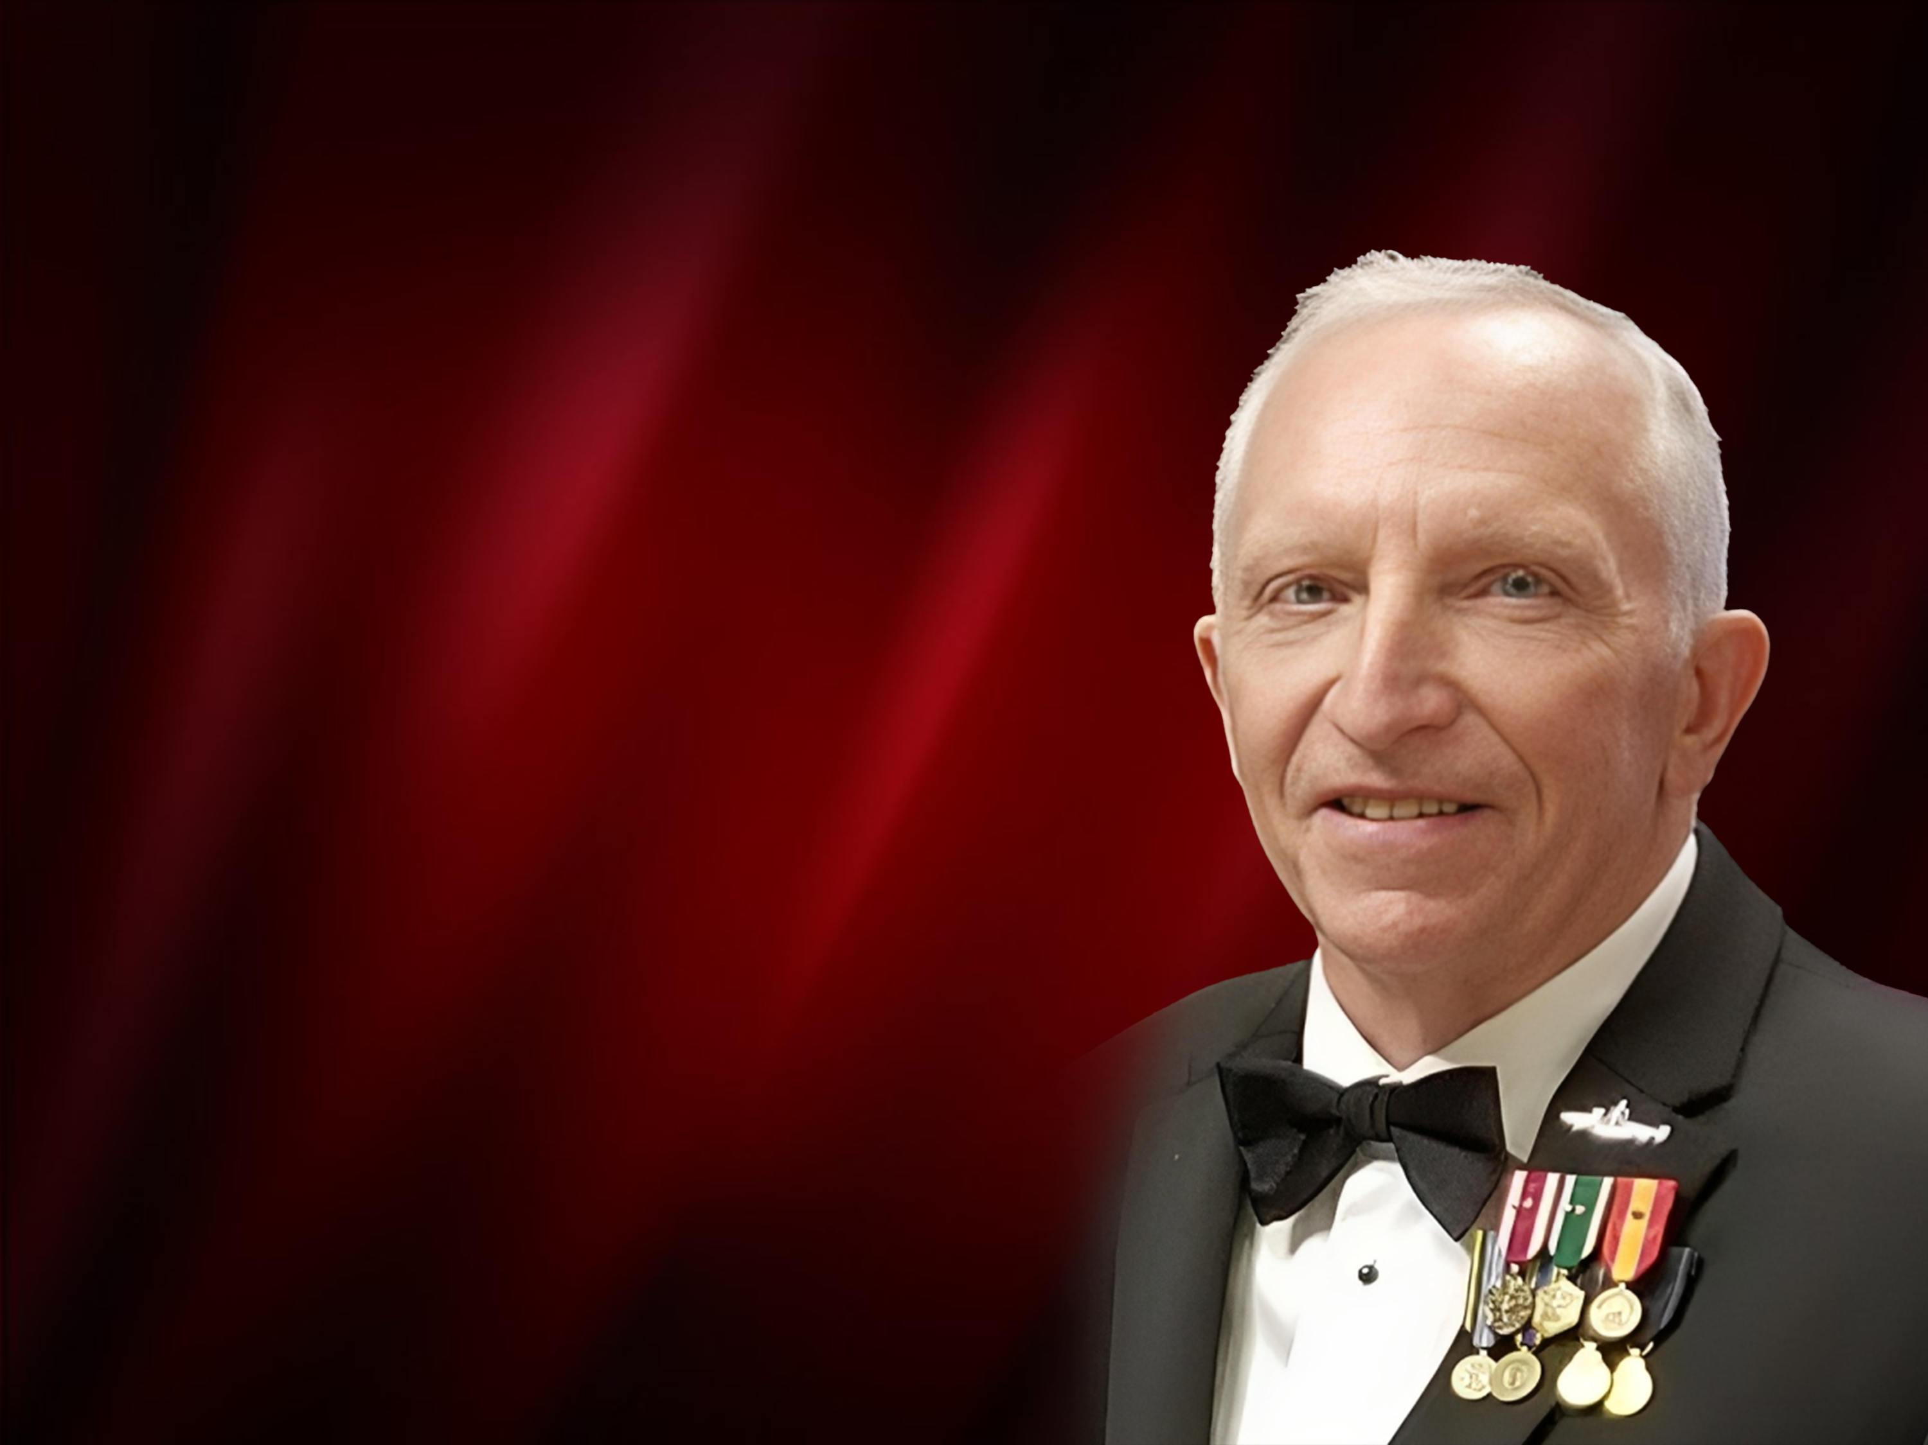
INVOCATION
BY
Steven L. Jensen
Commander, Chaplain Corps, US Navy (Retired)
Program Manager – Windward Wounded Warriors

Slide 5
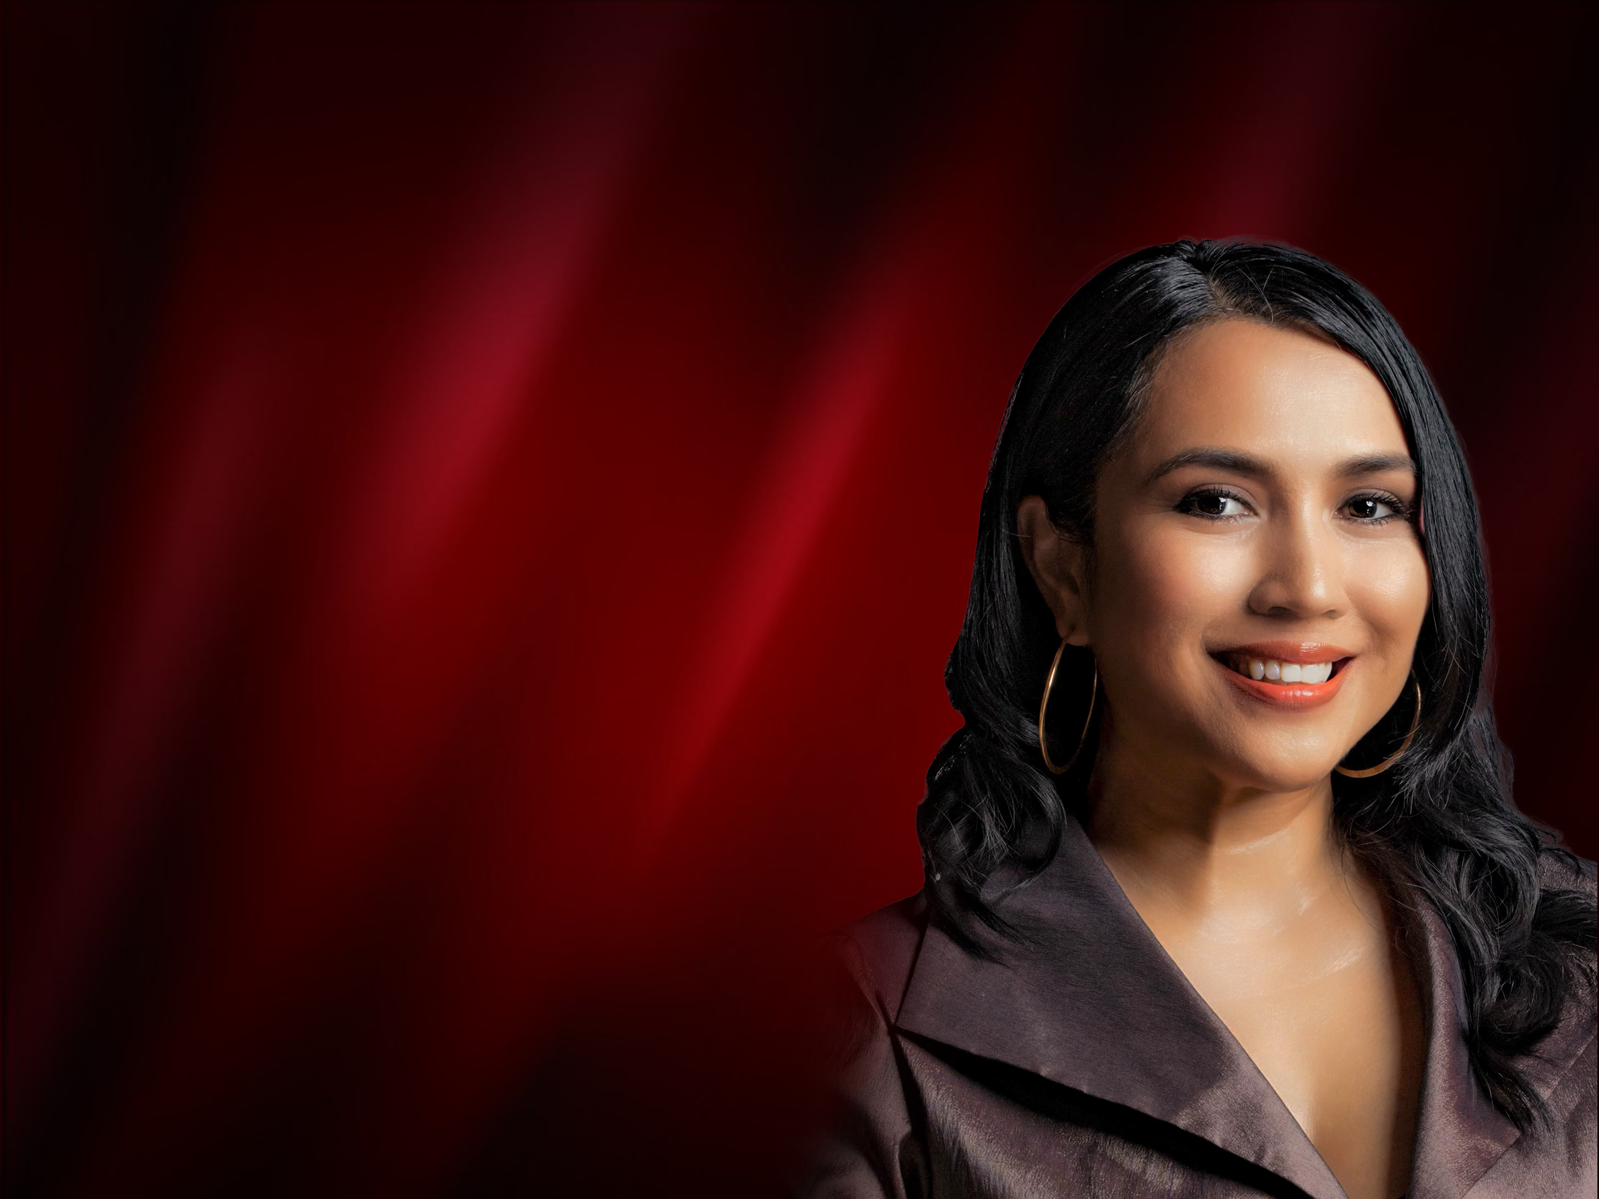
PERFORMANCE BY
KRISTIAN LEI
Internationally Acclaimed Performer, Producer and Community Development Advocate

Slide 6
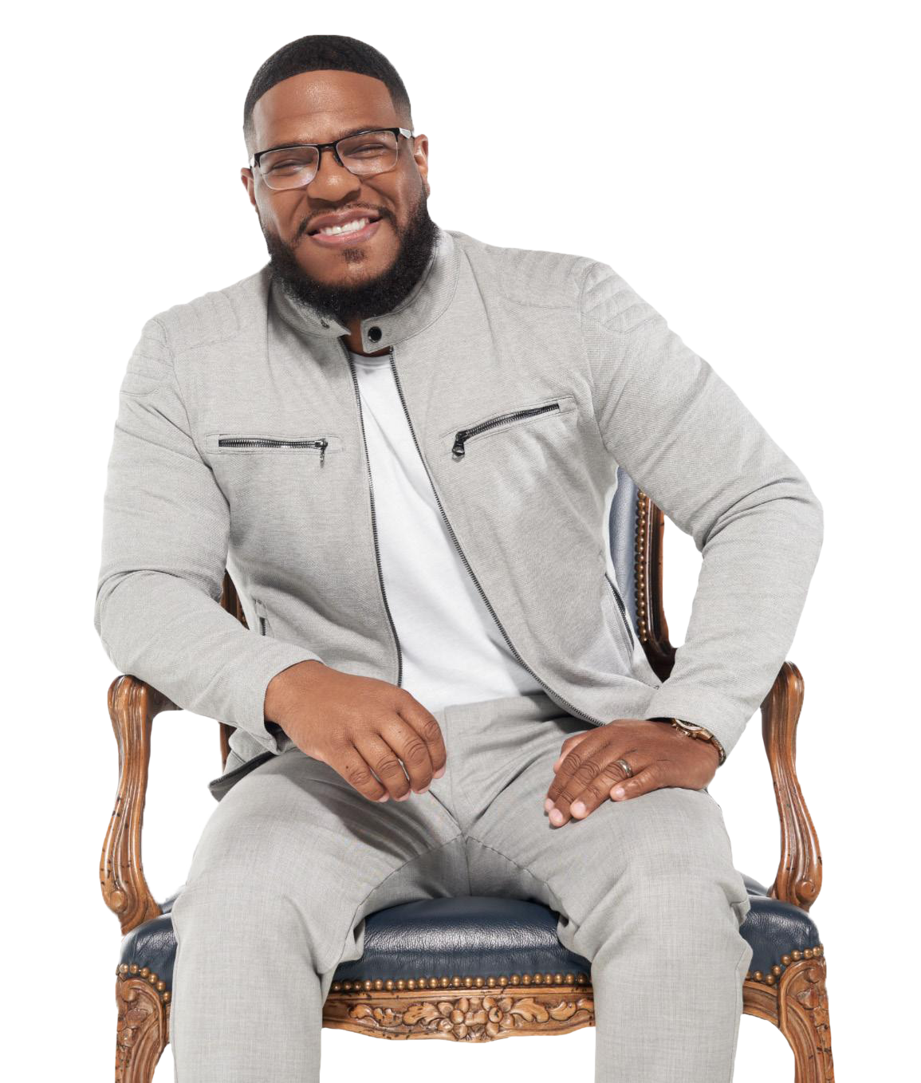
NATIONAL ANTHEMS AND ENTERTAINMENT
BY
SIR BILLY L.
DORSEY
GRAMMY AND STELLAR-AWARD WINNING ARTIST

Slide 7
ACCOMPANIED BY
MANA MUSIC QUARTET
Hawaii’s Premier Strings Quartet

Slide 8
THE
ROYAL
DINNER

Slide 9
HIS ROYAL HIGHNESS
PRINCE RAPHAEL
ANDUJAR Y VILCHES, PH.D.
PRINCE GRAND MASTER & SOVEREIGN
Of the Royal and Sovereign House of Cappadocia
and San Bartolome, or as proclaimed
Principality of Cappadocia

Slide 10
NOBLES
OF THE ROYAL HOUSE OF CAPPADOCIA

Slide 11
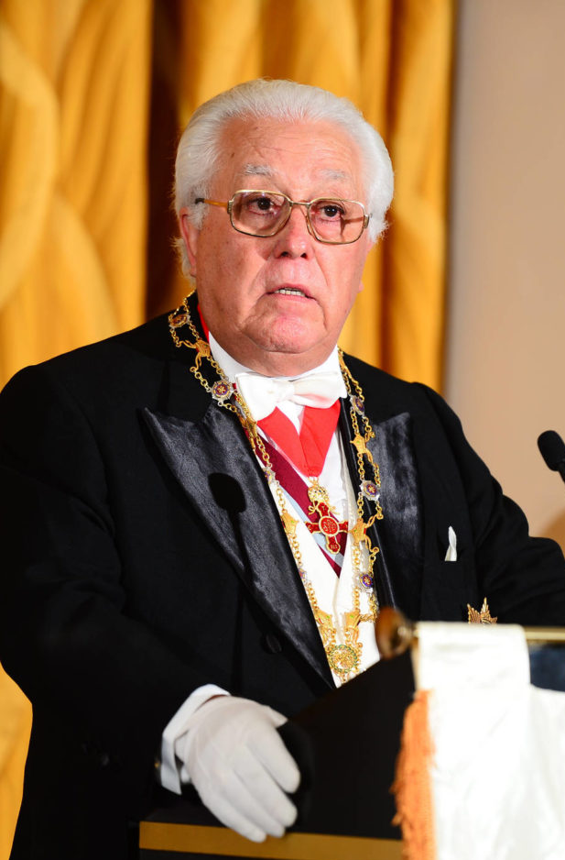
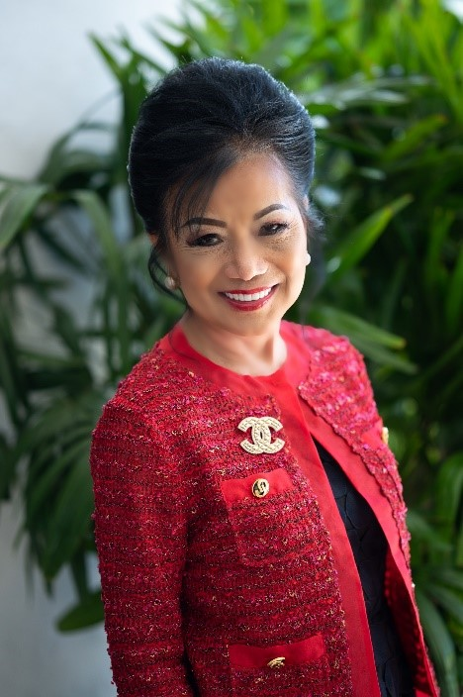
ROYAL HOUSE & ORDERS
HIS ROYAL HIGHNESS
HIS GRACE DUKE
HER GRACE DUCHESS
PRINCE RAPHAEL
ANDUJAR Y VILCHES, PH.D.
GERHART
WILHELM WALCH
DR. NANCY
ATMOSPERA-WALCH

Slide 12
H.E. MARQUIS LAURENT KAHIAT
OF SICILY
GRAND PRIOR OF JAPAN
&
H.E. MARCHIONESS KAYO ISHIKAWA

Slide 13
RECENT ROYAL
APPOINTMENTS
OF THE ROYAL HOUSE OF CAPPADOCIA
Chicago, June 11, 2023

Slide 14
GRAND PRIORS & PRIORS

Slide 15
H.E. BARON SIR ALEC STERN
BARON OF BOSTON OF CAPPADOCIA AND GRAND PRIOR GENERAL OF THE UNITED STATES

Slide 16
H.E. BARON SIR SIDNEY JOHN LELUAN III
BARON OF GUERNSEY OF CAPPADOCIA.AND GRAND PRIOR OF CENTRAL AMERICA AND LATIN AMERICA
&
H.E. BARONESS CONSORT DEBBIE LELUAN

Slide 17
H.E. BARON SIR DR. JAMES DENTLEY III
BARON OF SAINT JAMES OF CAPPADOCIA AND GRAND PRIOR OF ILLINOIS
&
H.E. BARONESS CONSORT DAME DR. KARA SCOTT DENTLEY

Slide 18
H.E BARON DR. JAMES DENTLEY III
SIR BRAD BLAZER
DAME DIDI WONG
DAME KRYSTYLLE LYNNE RICHARDSON
Baron of St. James of of Cappadocia and GRAND PRIOR OF ILLINOIS
GRAND PRIOR OF TEXAS
GRAND PRIOR OF FLORIDA
GRAND PRIOR OF ARIZONA

Slide 19
SIR BRAD BLAZER
DAME DIDI WONG
DAME KRYSTYLLE LYNNE RICHARDSON
SIR BILLY
L. DORSEY, JR.
GRAND PRIOR OF TEXAS
GRAND PRIOR OF FLORIDA
GRAND PRIOR OF ARIZONA
PRIOR OF HOUSTON

Slide 20
ROYAL HOUSE OF CAPPADOCIA,
CONSTANTINE THE GREAT AND ST. HELEN
KNIGHTING
INVESTITURE
HAWAII
October 28 2023

Slide 21
BARON SIDNEY LELUAN
GRAND PRIOR GENERAL OF CENTRAL AND LATIN AMERICAS
of The Royal Order of Constantine The Great and St. Helen

Slide 23
DAMES / LADIES
OF THE
ROYAL ORDER

Slide 24
LINDA GIANGRECO
ACHIEVEMENTS IN PHILANTHROPY

Slide 25
Congratulations
LINDA GIANGRECO
ACHIEVEMENTS IN PHILANTHROPY

Slide 26
YANNA
SAMKOVA
ACHIEVEMENTS IN ARTS AND PHILANTHROPY

Slide 27
Congratulations
YANNA
SAMKOVA
ACHIEVEMENTS IN ARTS AND PHILANTHROPY

Slide 28
KNIGHTS
OF THE
ROYAL ORDER

Slide 29
JAMES GRAY
ROBINSON, Esq.
ACHIEVEMENTS IN PHILANTHROPY

Slide 30
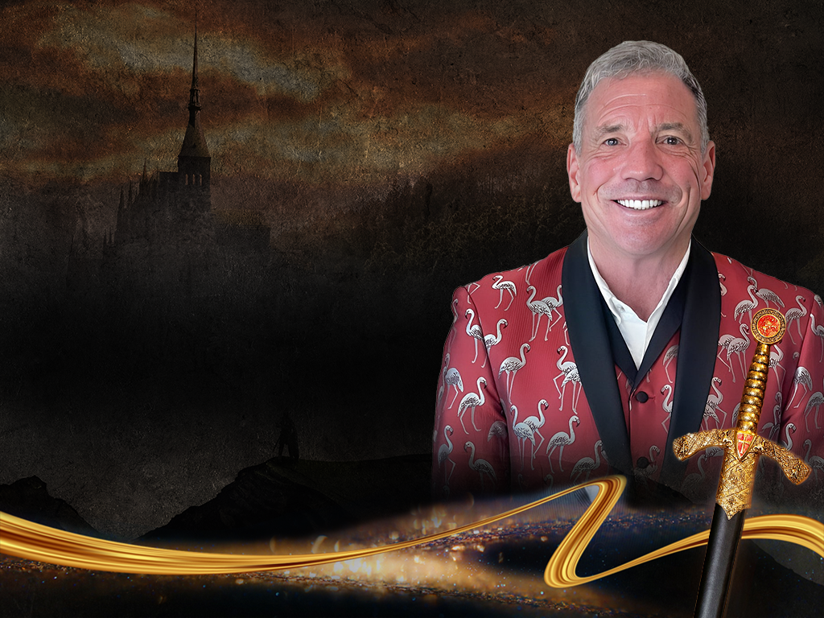
Congratulations
SIR JAMES GRAY
ROBINSON, Esq.
ACHIEVEMENTS IN PHILANTHROPY

Slide 31
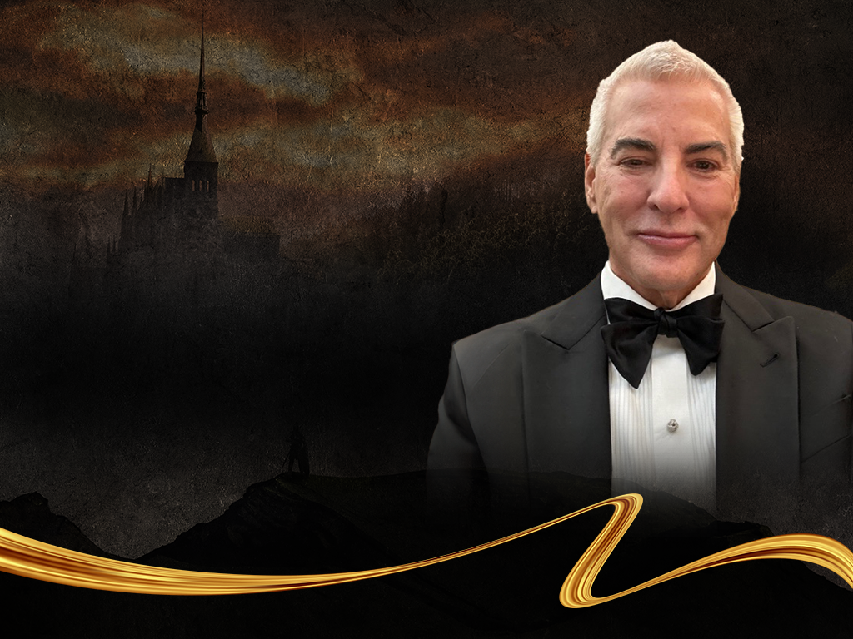
RONALD EUGENE
WILHELM, Esq.
ACHIEVEMENTS IN ENTREPRENEURSHIP

Slide 32
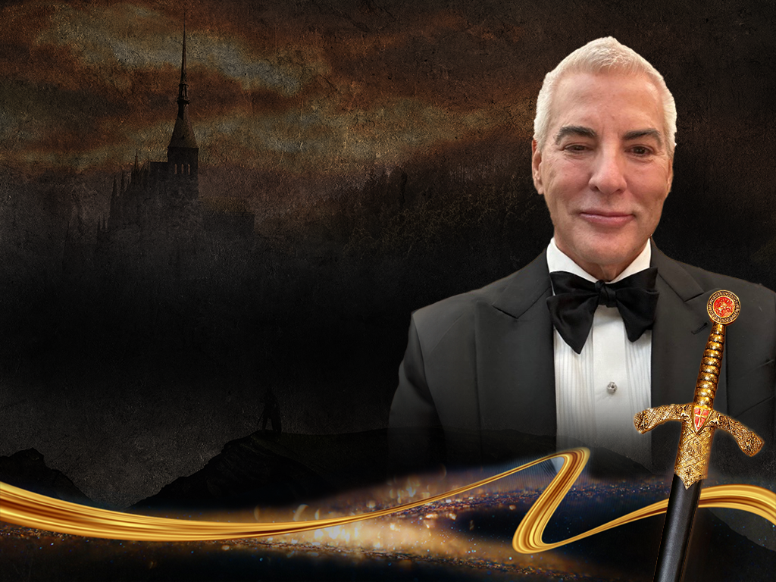
Congratulations
SIR RONALD EUGENE
WILHELM, Esq.
ACHIEVEMENTS IN ENTREPRENEURSHIP

Slide 33
KNIGHT COMMANDER, AND ADVISORY TO THE ROYAL HOUSE

Slide 34
H.E. SIR ANACLETO ALCANTRA, SR., ENG.,
KNIGHT COMMANDER AND ADVISOR TO THE ROYAL HOUSE

Slide 35
ADVANCEMENT IN NOBILITY

Slide 36
HER GRACE
DUCHESS DR. NANCY
ATMOSPERA-WALCH

Slide 37
Congratulations
HER GRACE
DUCHESS DR. NANCY
ATMOSPERA-WALCH
DUCHESS OF VIGAN OF CAPPADOCIA

Slide 38
NEW GRAND PRIORS
& PRIORS
OF THE ROYAL HOUSE OF CAPPADOCIA

Slide 39
SIR DON BOYER

Slide 40
Congratulations
SIR DON BOYER
KNIGHT GRAND CROSS AND GRAND PRIOR OF CALIFORNIA

Slide 41
DAME MELINDA BOYER

Slide 42
Congratulations
DAME MELINDA BOYER
DAME COMMANDER AND PRIOR OF ONTARIO, CALIFORNIA

Slide 43
SIR KAYA REDFORD

Slide 44
Congratulations
SIR KAYA REDFORD
KNIGHT COMMANDER AND PRIOR OF LOS ANGELES, CALIFORNIA

Slide 45
SIR ROLANDO BLACKMAN

Slide 46
Congratulations
SIR ROLANDO BLACKMAN
KNIGHT COMMANDER AND PRIOR OF DALLAS, TEXAS

Slide 47
TO SUPPORT OUR CHILDREN'S CHARITIES
PLEASE VISIT TO OUR WEBSITE
www.myroyalorder.org
&
Visit to Donate

Slide 48
SPECIAL
THANK YOU
H.R.H. PRINCE RAFAEL ANDUJAR Y VILCHES
HON. RICK BLANGIARDI, MAYOR OF HONOLULU
HILTON HAWAIIAN VILLAGE RESORT, WAIKIKI
ADVANTAGE HEALTH CARE PROVIDER
ASCIRA – MARKETING PLATFORM
THE IOLANI PALACE
THE PACIFIC CLUB
PEARL HAVEN CAMPUS
GOVERNOR JOSH GREEN, M.D.
REP. JOHN MIZUNO STATE OF HAWAII
STEVEN JENSEN, CHAPLAIN (COMMANDER US NAVY RET.)
OFFICERS AND MEMBERS OF THE UNIVERSITY OF HAWAII ROTC COLOR GUARD
OFFICERS AND MEMBERS OF THE GRAND PRIORY OF HAWAII
OFFICERS AND MEMBERS OF THE ROYAL ORDER AND ITS GRAND PRIORIES
OFFICERS AND MEMBERS OF THE VIGAN ASSOCIATION OF HAWAII
WINDWARD WOUNDED WARRIORS' ASSOCIATION

Slide 49
SPECIAL
THANK YOU
OUR ENTERTAINERS
SIR BILLY DORSEY
KRISTIAN LEI
THE MANA MUSIC QUARTET
AND THE ALOHA DANCE SPORT CENTER

Slide 50
SPECIAL
THANK YOU
THE WORKING AND SUPPORT TEAM
ALOHA GRAPHICS
LEO ARISTA
BENJI ARISTA
SIR JIM BOERSEMA
BARON DR. JAMES DENTLEY iii
BARONESS DR. KARA DENTLEY
BARON SIDNEY LELUAN III
BARONESS DEBBIE LELUAN
PRINCESS JUAN
PAUL KLINK
LADY JESSICA MUNOZ
SIR DR. JOHN SACHTOURAS
LADY YANNA SAMKOVA
GLENN SAGAYADORO
ADELA SALACUP
REMY BRION, MARIA HANDL AND GROUP
BARON ALEC STERN
JOE TEIPEL
DUKE GERHART WALCH
MAHALO TO OUR
SPONSORS, DONORS AND SUPPORTERS AND
ALL OUR GUESTS FROM HAWAII AND FROM AFAR

Slide 51
OUR DEEPEST GRATITUDE TO EVERYONE WHO HAS HELPED US IN MAKE A ROYAL SUCCESS. IF WE MISSED ANYONE IT WAS NOT INTENTIONAL, WE APOLOGIZE SINCERELY.
DUCHESS DR. NANCY ATMOSPERA WALCH
ROYAL RECOGNITION EVENT CHAIR

Slide 52
THANK YOU

